Slide 1
Appdynamics Engineer Training: Chapter 1 Selling AppDynamics
Notes:
Welcome to the AppDynamics Engineer training program! My name is Sandro Guglielmin, I am responsible for the technical enablement of Sales Engineers and Consultants of both AppDynamics as well as our Partners.
This is the first chapter of a training course where we will cover all aspects related to AppDynamics’ solution, including
technical sales
product capabilities
competitive differentiation
demonstration
management of Proof of Concepts
Installation
Configuration and
Troubleshooting
As you have probably already seen already, there are a number of chapters still to come still. Please take your time to complete this course, got thru each chapter 1 by 1, complete the labs and understand each chapter thoroughly. Feel free to submit questions to by email should you have any problems with attending the course or any part of it’s content.

Slide 2
What’s this about?
We will take a look at the APM Market Space, at Appdynamics’ Value Proposition and the competitive Landscape. We’ll use Gartner’s “Magic Quadrant’ and Gartners “5 Dimensions for APM” to do so.
At the end of this chapter you should have an overview of how to best position and defend Appdynamics and feel confident to be able to successfully engage your customers.
Notes:
In this chapter we take a overview of the APM market space. We’ll do this using Gartner’s 5 dimension of APM and it’s magic quadrant to position and highlight the AppDynamics solution and the benefits it brings to customers as well as to best differentiate against the competition.
At the end of this chapter you should feel comfortable in articulating our value proposition and at a high level differentiate and defend it in your sales engagements with prospects and customers.

Slide 3
Overview
The Application Performance Management (APM) Market opportunity
AppDynamics Value Proposition
The Gartner “5 Dimensions for APM”
The Gartner “Magic Quadrant”
Unique Differentiators
Demo
Notes:
Here is an overview of the topics in this chapter
we will focus on the aspect of selling AppDynamics. We will define the Market space and why we believe there is a major opportunity to be taken advantage of. We will use the Gartner ‘5 dimensions for APM’ and the Gartner Magic Quadrant to best position AppDynamics.
This is all at a very high level and is not touching any of the technology yet, don’t worry we will get there soon enough. It is however helpful to understand the sales message that we have set for AppDynamics in order to best highlight it’s benefits and differentiating the product in the marketplace.
We will conclude this chapter with a demonstration. This will also serve as an introduction for you to our demo systems as we expect you to become proficient in demonstrating AppDynamics to your customers by yourself.

Slide 4
The APM Market opportunity
Application performance management (APM), is the discipline within systems management that focuses on monitoring and managing the performance and availability of software applications. http://en.wikipedia.org/wiki/Application_performance_management
“In short, software is eating the world.” Marc Andreessen http://online.wsj.com/article/SB10001424053111903480904576512250915629460.html
Notes:
Why is Application Performance Management a opportunity today? The APM market space is not new, it has been pioneered over 10 years ago and there are lots of vendors big and small competing in this market. So, why would there be potential for a new, unlocked business opportunity?
Consider that across all industries companies are moving from using software to automate and improve efficiency of their operations (like in accounting or customer management or shop floor automation) towards using software as their main enabler to drive business and beat competition! Marc Andreessen, Co-Founder of Netscape has captured this trend and it’s significance in this Wall Street Journal article and I recommend you to read it before continuing here.
click - red arrow flying in
Let’s contrast this with the role of APM, here captured by it’s Wikipedia definition. This article aside from framing the role of APM within Systems Management emphasizes its one major focus, ensuring the performance and availability, the QUALITY in one word, of software delivery.
Again, I encourage you to read the entire article, but it should become evident to you that APM will become or continue to be a major focus of investment for a growing number of companies as they need to ensure the quality of service of their software in order to compete on the market.
Also consider the fact that the complexity of that software is only increasing, fueled by the drive towards distributed, service oriented architectures, virtualization and pushing applications into the cloud. We at AppDynamics can see this already. Our customer base comprises companies who’s business is their web presence (netflix) as well as those that are shifting more and more of their delivery channels to the Web (Williams Sonoma). There is no question for them that they need APM, the only question to answer here is which is the best APM they can get today.
And here is where you come in, You will be representing AppDynamics in front of your customers. As an SE, your best argument to back the response, that AppDynamics is the best APM today, is your credibility! At the end of the day if your customer does not give you his or her confidence it does not matter what you say or how you say it. It is the conviction that the market trends that we just outlined are in fact correct and that our product is the right technology to address the challenges that come with them that makes you credible. This course will give you the knowledge you need and practice will give you the confidence. With this knowledge and confidence you will be able to map AppDynamics’ capabilities to the customers requirements and clearly show the value that a customer can achieve with our solution. Let’s talk about that next.

Slide 5
AppDynamics Value Proposition
So what is it we do?
Monitor end user experience
Capture root cause analysis details
Map transactions in distributed environments
Automate routine operations
All true, but is that really the value?
What is the benefit if the customer does all the above?
To manage the Quality of Business Services
In Production (meaning with low eead)
During development
Notes:
So what is it that AppDynamics does? We are an APM solution after all. So we should be able to so
Click – list of capabilities appear
say these things among others. And we can do all this and be very smart about it too! Meaning we can do all this with very low overhead, that is only consume minimal amount of extra cpu power to do so!
Click – question 1 appears
But is this really why someone would spend money? Don’t get me wrong the people in operations, the people in development are looking for capabilities like this and with them you will need to talk about and differentiate these capabilities. My point here is
- Click – question 2 appears
that the reason why somebody is willing to part with money is not given with these capabilities. It is given by translating these capabilities into a benefit that is higher then the actual cost of the software! This is really enterprise software sales 101 and am sure you know all this already. So, now what is the benefit of using AppDynamics?
Click - Value statement appears
TO MANAGE THE QUALITY OF BUSINESS SERVICES and
Click – value details appear
To be able to do this in real time in production as well as in a agile, high frequency software development life cycle! Of course this is a very high level value statement and I did say before that it is your job to map product capabilities to the customers requirements. When you do this be aware however that not to simply match a requirement to a feature, instead map a requirement to a concrete value. Values that can all be subsumed in this one statement. Every customer and every engagement will be different. What is relevant to one customer may not be to another one, value is a perception of the individual, not of the product. Help the customer to see the value of the product but do so thru his eyes. The best way to do that is by staying true to the customers requirmements.
Let’s now take a bit of closer look at those. We will use the 5 Dimensions for APM that Gartner, the Analyst firm, has established to categorize these requirements at a high level and enable you to conduct a focused, credible discussion.

Slide 6
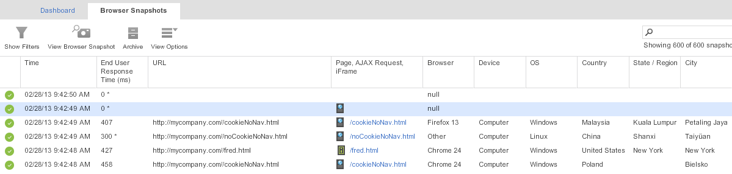
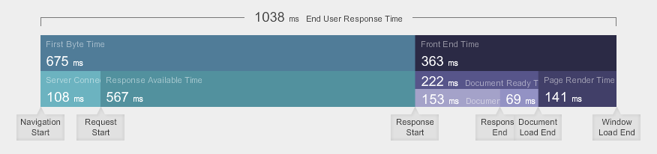
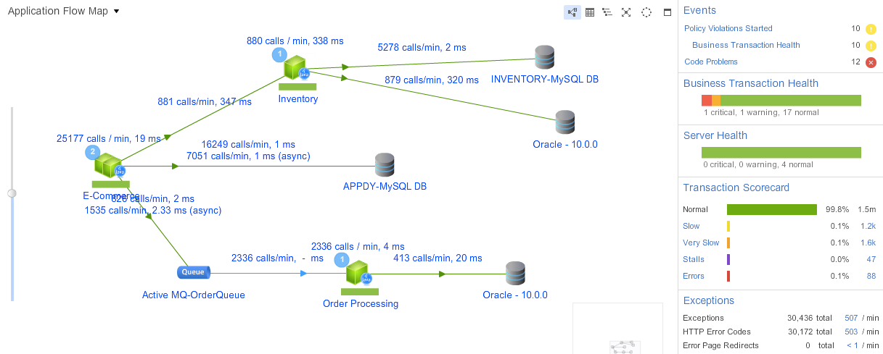
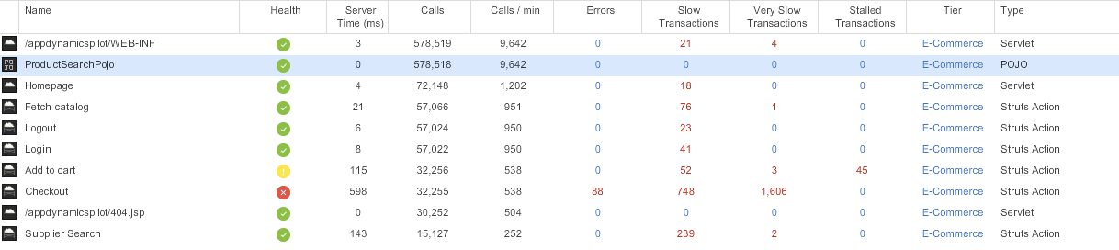
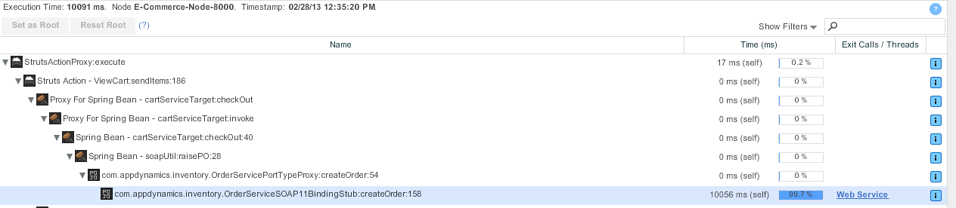
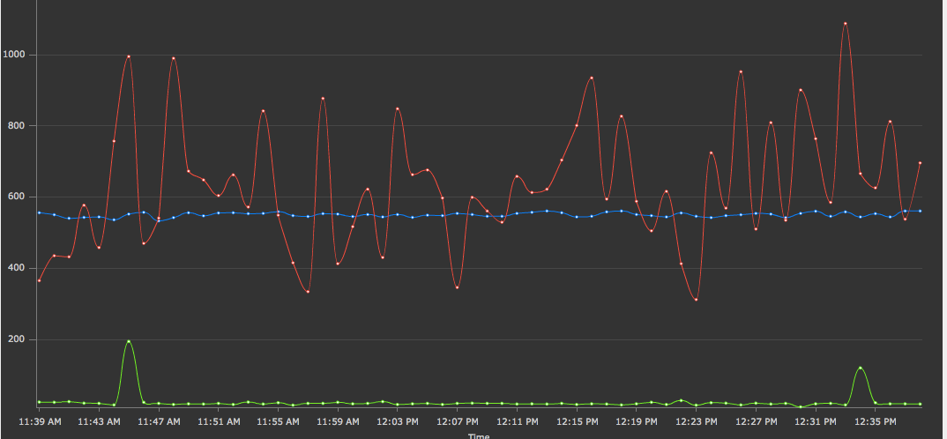
The 5 Dimensions for APM
http://www.apmdigest.com/gartners-5-dimensions-of-apm
End-user experience monitoring
Application runtime architecture discovery and modeling
Business Transaction Management
Application component deep-dive monitoring
Application data analytics
End-user experience monitoring
Application runtime architecture discovery and modeling
Business Transaction Management
Application component deep-dive monitoring
Application data analytics
Notes:
These are the 5 Dimensions Gartner has stipulated to be descriptive of APM. It is important to understand that neither category is of higher priority than another and that although a company will typically select a strategic APM vendor, not all dimensions may be fulfilled by the same product. AppDynamics is best suited to be the ONE product to support all 5 dimensions (and more). Very few competitors are in such a position although that does not stop them from making the claim . We will take a deeper look at the competitive landscape a bit later, but suffice to say for now that other vendor solutions largely consist of products cobbled together that were brought in by acquisitions.
As I said before, There is no ranking to this order and you may see your customer approach APM from the one or the other dimension first. It should be your goal to satisfy that dimension or requirement first. Depending on the customers mind set it may be of advantage to point out the other capabilities, however be careful not to overwhelm the customer by broadening the scope of the project and risk to escalate their APM initiative to a ‘strategic’ level. AppDynamics does favor a land & expand approach, get a first small win by supporting a particular use case and expand into other areas later.
Let’s take a look at each Dimension
Click - list changes font size
Click – EUM screenshot appears
End User Experience lots of acronyms fill this space like, EUEM, EUM, RUM, UEM. The aforementioned Wikipedia article gives a good explanations of what these acronyms mean and how they fit in the overall picture. It is fair to say that AppDynamics approach to this dimension fits into the UEM, User Experience Management domain as we use a agent driven, java script injection based technology. It allows for accurate end user behavior monitoring as well as the monitoring of external resources, like monitoring the latency of serving up content from third parties like ad networks.
Click – Flow Map screenshot appears
Application Runtime Architecture While End User Experience is considered a top down approach (from the end users perspective) this dimension is considered bottom up as it enables the mapping of all components of the application at run time. Gartner considers this dimension of secondary importance, AppDynamics however strongly emphasizes this capability. In order to enable this capability AppDynamics automates the process of mapping the application architecture. The Gartner definition does not make this a requirement, essentially leaving the mapping open to a manual configuration process.
Click – BT List screenshot appears
Business Transaction Management As with the Application Runtime Architecture, AppDynamics automates the process of Business Transaction identification, we call this process Auto-Discovery. Business Transactions are the backbone upon which AppDynamics is built. IT enables the ability to correlate and measure execution across multiple components in a business context and thus provide an indication of the quality with which an application delivers its services to end users.
Click – Call Graph screenshot appears
Application Component Deep Dive Monitoring This Dimension is described by Gartner as “ the runtime view of the J2EE and .NET … giving you a clear path of the code execution”. Historically speaking, this capability is what APM tools were all about and some of the products in this space still have this focus. Do not make the mistake of underestimating this dimension as to be ‘too technical’ or not providing business value. A big part of the management of the quality of business services is about problem identification and remediation. The capturing of deep code execution details is a cornerstone of this ability. Since it is one of the first functional capabilities of APM tools you can expect other products to have this capability as well. With AppDynamics however, deep dive diagnostics are tied to the business transaction, not the Application components. It becomes thus very easy to tie problems that were hidden in the code execution to the actual business activity and thus revealing the impact these problems have on the business. As I said before, you may want to adapt to your customers requirements and use cases and focus on those. Let me just say at this point that when you articulate the benefits of AppDynamics, statements like “We help you find problems in your code quickly by enabling root cause analysis” are fine and true, however they also are descriptions of technical capabilities. From a business perspective the phrase should be “With AppDynamics you ensure the quality of Service of your Business Applications, from the Customer Experience all the way to the Infrastructure Management”. This sets the boundaries of what AppDynamics can do in more accurate context.
Click Chart screenshot appears
Application data analytics Gartner describes this ability as “to collect the raw data from the other tool sets that will allow you to answer a wide variety of performance questions as they arise”. Interestingly enough, the assumption is that one uses a number of tools to accomplish APM. With AppDynamics we already have the data in a single repository allowing us to chart and analyze without the use of other ETL or BI tools. AppDynamics also offers a REST API that allows programmatic access to the data. In our opinion a relevant aspect of APM is entirely omitted from these 5 dimensions. That aspect is automation, the ability to automate all tasks that are necessary to ensure quality of service. Many solutions exist that ensure automation of code build, of application deployment, of change management. At AppDynamics we believe that performance management should play an active role in the automation of operations both in the development phase as well as in operations. It may very well be that Gartner will consider this aspect when it publishes it’s Magic Quadrant for 2013. But let’s take a look at the current Magic Quadrant.

Slide 7
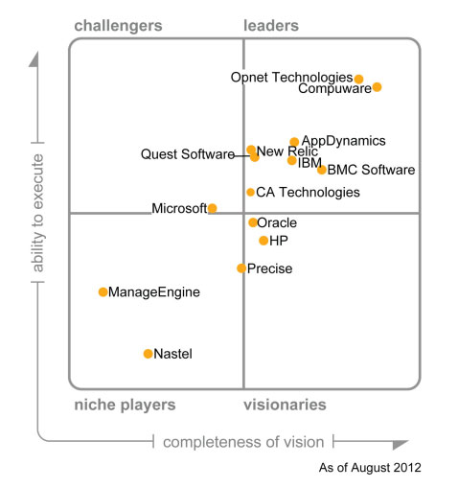
The Gartner “Magic Quadrant”
Notes:
The Magic Quadrant is a report recognized in the industry and many organizations do rely on it to consider potential vendors. AppDynamics has been placed in the leaders box the first time it appeared on the Magic Quadrant! This is a terrific achievement and we have already left much bigger companies behind us thanks to the technology and the value it provides to customers. While it is perfectly ok to use our position in the magic quadrant with confidence when engaged in sales opportunities we should keep measured opinion and not overestimate see that there is room for improvement.
Click – arrow appears
Our number one competitor right now is Compuware DynaTrace and they are placed ahead of us. It will be important that you clearly understand the differentiation between the 2 products as it is very likely that you will encounter them in the field and compete against them. Make no mistake, theirs is a good technology and as with any technology it has advantages and disadvantages. In a competitive situation it will be most important that you influence your customers requirements and expectations to favor AppDynamics strengths. The good news is that AppDynamics and DynaTrace’s strengths and weaknesses are almost diametrically opposed, thus positioning a strength of AppDynamics also positions a DynaTrace weakness. We will get into the competitive differentiation in a minute, suffice to say for the moment that you should always make sure that “production” is the main use case in a competitive situation.
It is our goal to overtake Compuware in 2013 and we certainly do have the innovation and momentum to do so, in the field it is, as always a ‘one deal at a time’ battle, so keep your head down and focus on meeting and exceeding your customers requirements and expectations.
Click – arrow appears
While we race to overtake Compuware we need to make sure we are ourselves not overtaken by New Relic. The good news here is that we feel that whatever we do to get Compuware also keeps us ahead of New Relic as they too will innovate to try to close the gap they have against us. The main threat from new Relic is that they play the ‘landgrab’ game, signing up lots of small customers using their easy-to-use (ast they call it), saas based solution. We actually heard from a customer that he used New Relic until he was able to ‘take the ‘APM training wheels off’ and now uses AppDynamics. This statement is a very good assessment. We have a superior technology and deliver more value, however a company’s strategy on how to attack the market can play an important part on how it is positioned in the marked and thus in consequence prompts us how to compete against it. AppDynamics offers Saas services as well, and provides APM thru a number of Cloud Providers. With this effort we should meet New Relic on their own turf, since most of that activity is however based on a ‘try it yourself’ basis, you as an SE should not be involved in it.
We will have more on Competition, on how to best position against particular Competitors in a spearate Chapter later on. Let’s now focus on the unique differnentiators of AppDynamics
.

Slide 8




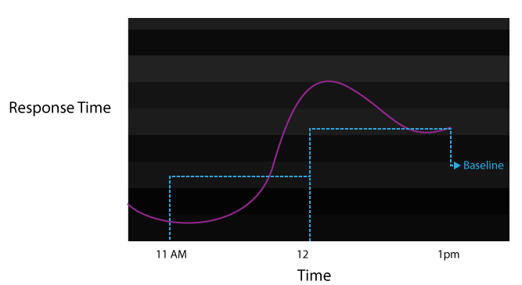
Unique Differentiators
Intelligent Agents!
big deal … we got
Yo, we got Agents!
Transaction Discovery
Dynamic Baselining
Tomcat
Release 1.1
Release 1.2
Release 1.23
Release 1.5
.NET
Amazon EC2
Windows Azure
Release 2.4
Release 2.5
Release 2.6
Release 3.0
Tomcat
Mule, Tibco, AG
CLOUD
Login
Search Flight
View Flight Status
Make Reservation
WEB 2.0
ESB
Tomcat
VMWare
Weblogic
Memcached
Oracle
Release 4.4
Release 4.5
Release 4.6
Release 5.0
Browser Logic
AJAX
Web Frameworks
Release 1.4
Release 1.5
Release 1.6
Release 2.0
SOA
Coherence
Hadoop
Cassandra
MongoDB
Release 3.4
Release 3.5
Release 3.6
Release 4.0
.NET
MQ
JBoss
AGILE
Release 1.4
Release 1.5
Release 1.6
Release 2.0
BIG DATA
SQL Server
ATG, Vignette,
Sharepoint
Notes:
We know from the Value Proposition that we enable customers to manage the Quality of Business Services, and we know that we have a series of capabilities to do so. But how are these different, What makes AppDynamics really unique?
Click - agent animation (let it play out to “intelligent Agents”)
A lot of what makes us unique in the market place is how our agents work. Nearly all competing products work on the basis of adding an agent to the application runtime environment and we will learn the technical details about how this is done later. AppDynamics agents however work differently and we frame this discussion by asserting that our agents are intelligent. That intelligence allows our agents to make decisions in real time, while a transaction is executing as opposed to simply acting as a data pump, gathering data about the runtime behavior of an application and sending it to a server to analyze ‘post mortem’ so to speak, which by the way is how most agents of competing products work.
The agent’s intelligence is most prominent in 2 major areas, the ability to Identify Transactions at runtime and the ability to selectively take snapshots of requests.
Click – bullet point Transaction Discovery
AppD’s agents discover transactions! If this seems like a forgone conclusion to you, if you just thought ‘ok what’s the big deal?’, think again.
Most other tools measure and track requests indiscriminately and present the data perhaps ordered by by the url, in case of http requests. The notion of a business transaction is at best an afterthought with such an approach, perhaps implemented as a filter on the server on which the data captured by the agents is aggregated.
With AppDynamics business transactions are a first class concept and the agent goes out of his way to correctly identify requests and assign them a proper classification or categorization. Think of it this way, requests are invocations of a given business transaction and are implicitly distributed, meaning if there is more then one distinct Service involved in the processing of that request, the execution is followed and automatically correlated. Remember what we said before, the trend towards Service Oriented Architectures means that more and more distributed, interconnected systems are in need of monitoring.
The notion of a business transaction that provides the ‘end user’ perspective of how these system work together to respond to single request is immensely valuable. Why? Because the measured performance is now not related to the systems that provide the service but to the users that consume it! Think of it at looking at the application’s performane from the end users point of vie top down as opposed to a system’s monitoring solution looking bottom up.
Click – bullet point Dynamic base-lining
Every business transaction, every metric in fact is base-lined. What does this mean. A baseline, the hourly average for a metric is compute automatically and used to determine whether a metric is within ‘normal ‘performance boundaries or not. These boundaries can be expressed as thresholds either in percentages or standard deviations as well as other configurations. The point to understand is that since baselines are implicit, AppDynamics becomes automatically aware of an applications performance pattern over time and over different time frames, like the last 10 minutes compared against the last 10 minutes of the previous hour or the same hour yesterday.
With this understanding AppDynamics can now spring into action, decide whether a request is performing normally or not and do different things depending on the outcome of that decision. Remember what I said before, we can capture root cause analysis details with very little overhead. The way we do this is based on being able to make the differentiation between normal and not normal performance and only capture root cause analysis details when they are actually needed.
We will talk about all this in more detail in the following chapters, so let’s jut let this sink in for a minute. AppDynamics agent are intelligent, pro-active and learn an application's performance profile. With that understanding we are a better performance management solution than any other approach that simply collects data and defers that understanding to people and to later point in time.

Slide 9
Demo
Notes:
To conclude this chapter let’s now go thru a demo of the product.
This demo is both a first look of the User Interface for you as well as seeing the things we just talked about in action. With the next chapters you will gather gradually gather a deeper understanding. Do not forget however that your customers will not have your inside knowledge, so this demo is the first thing they will see as well and it is going to be yourself delivering this demo. Come back to this chapter and replay the demo as many times as you need to get a feel for the key points to make in a first meeting.
Thank you for your time attending this chapter.

Slide 10
End of Chapter 1 Selling AppDynamics

Slide 11
Distributed Applications
Release 1.1
Release 1.2
Release 1.23
Release 1.5
.NET
Amazon EC2
Windows Azure
Tomcat
CLOUD
Release 2.4
Release 2.5
Release 2.6
Release 3.0
Tomcat
Mule, Tibco, AG
ESB
Tomcat
VMWare
Login
Search Flight
View Flight Status
Make Reservation
WEB 2.0
Memcached
Weblogic
Oracle
Release 4.4
Release 4.5
Release 4.6
Release 5.0
Browser Logic
AJAX
Web Frameworks
Release 1.4
Release 1.5
Release 1.6
Release 2.0
Coherence
SOA
Hadoop
Cassandra
MongoDB
.NET
MQ
JBoss
AGILE
Release 3.4
Release 3.5
Release 3.6
Release 4.0
Release 1.4
Release 1.5
Release 1.6
Release 2.0
BIG DATA
SQL Server
ATG, Vignette,
Sharepoint
Notes:
Modern applications are harder to manage because they are
More complex
Change faster
The only constant as apps have changed is the “business transaction”

